Slide 1

Review for Plotting with EDA
2019

Slide 2
How do we organise these tasks?
Cleanup
Read CSV
Clustering
ANSWERING
Join
Get the data
Model
Random Forest
Set Index
Linear Regression
Fill NAs
Bar Plot
Scatter Plot
QUESTIONS
Aggregate
Distplot
Plot
Explore Data
Countplot
Correlations
Countplot

Slide 3
ANALYSIS AND INTERPRETATION How to choose the right plot for your problem?
Change over time
Part of a whole
Flows and relationships
Ranking
Geospatial
Comparison 🗸
Correlation 🗸
Distribution 🗸
Source https://flourish.studio/2018/09/28/choosing-the-right-visualisation/

Slide 4
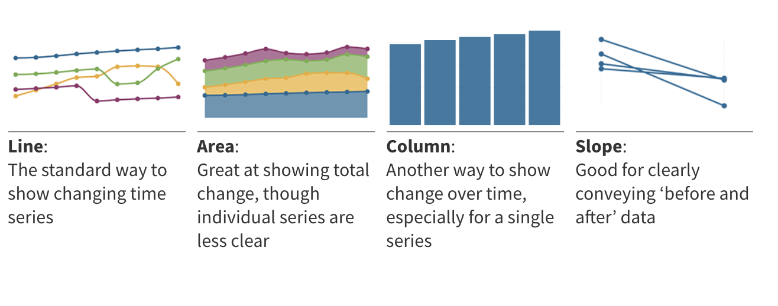
ANALYSIS AND INTERPRETATION Model change over time
Source https://flourish.studio/2018/09/28/choosing-the-right-visualisation/

Slide 5
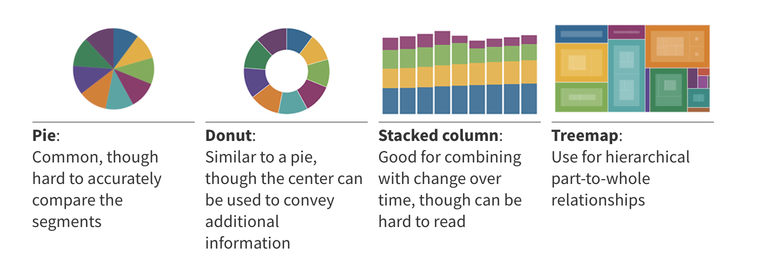
ANALYSIS AND INTERPRETATION Model part of a whole
Source https://flourish.studio/2018/09/28/choosing-the-right-visualisation/

Slide 6
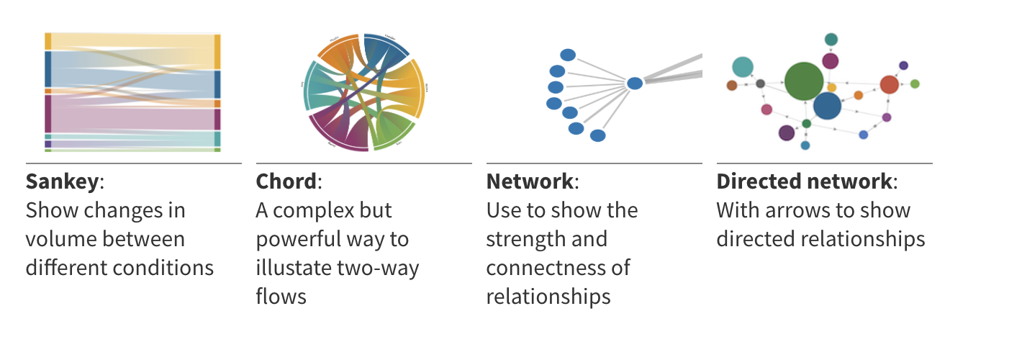
ANALYSIS AND INTERPRETATION Model Flows and relationship
Source https://flourish.studio/2018/09/28/choosing-the-right-visualisation/

Slide 7
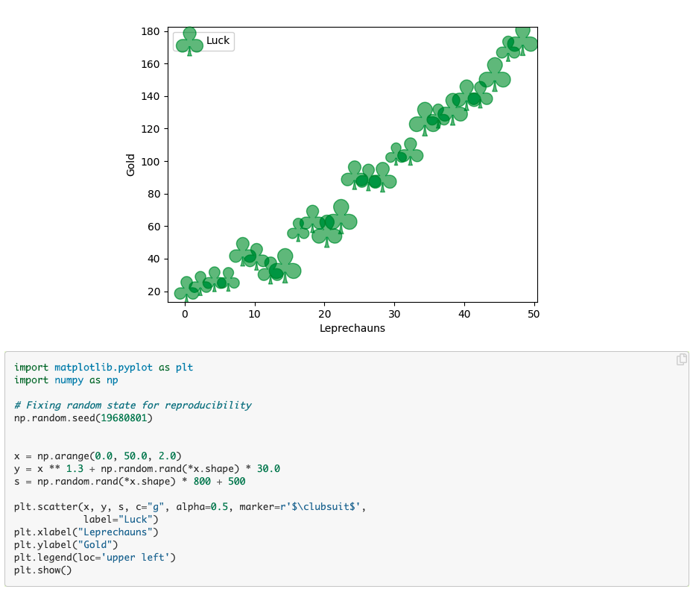
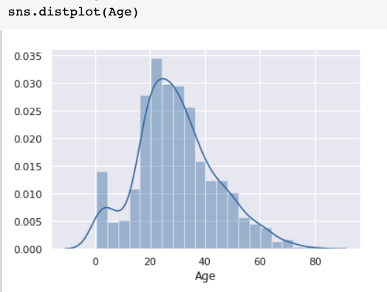
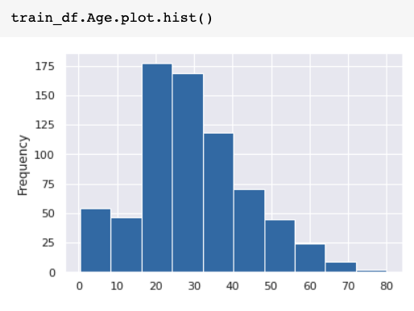
PRACTICE - BASICS Plotting libraries for Python
Pandas builtin plot function
Seaborn
Matplotlib
Ease of use
Flexibility

Slide 8
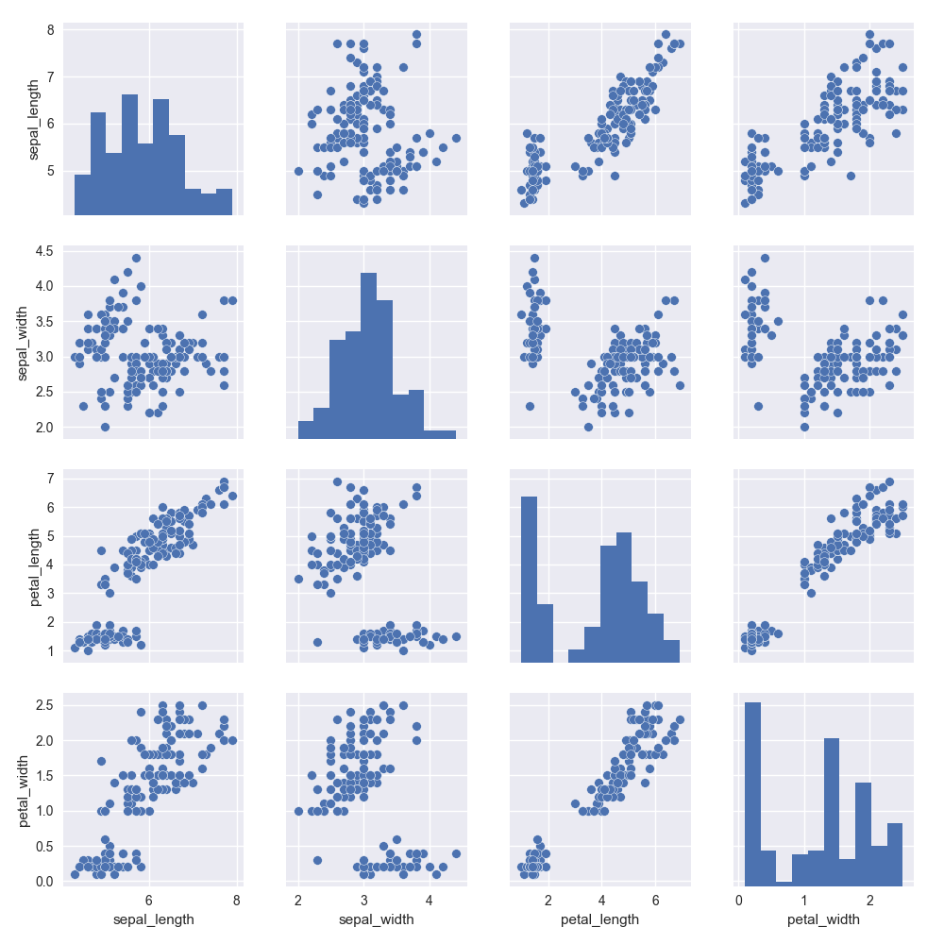
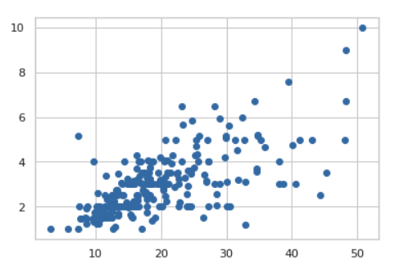
PRACTICE - BASICS Types of plots and which questions they answer
Univariate
Bivariate
Multivariate
How does this variable behave?
How is it distributed?
Are there outliers?
Does it reflect more than one population?
How do these two variables correlate?
Does a change in one predict a change in the other?
How strongly or weakly do they correlate?
What possible correlations can we find?
Does a joint change in a set of variables predict a change on our target variable?

